Slide 1

Feature Engineering, Weight Of Evidence(WoE), and Information Value (IV)

Slide 2
Introduction to Feature Engineering
Feature engineering is the process of using domain knowledge to select, modify, or create features (input variables) that enhance the performance of machine learning models.
It involves transforming raw data into a format that is better suited for predictive modeling. This can include:
Creating new features: Combining or transforming existing features to create new ones that capture relevant information.
Selecting features: Choosing a subset of relevant features from a larger set to improve model performance and reduce complexity.
Transforming features: Modifying features to meet the assumptions of a model, such as normalizing data or encoding categorical variables.
Notes:
In essence, feature engineering is crucial for improving the accuracy and interpretability of machine learning models.

Slide 3
Importance in Machine Learning and Credit Scoring
Improved Model Performance: Well-engineered features can significantly enhance the predictive power of a model, leading to better accuracy, precision, and recall.
Reduction of Overfitting: By selecting only the most relevant features, feature engineering helps reduce the risk of overfitting, where a model performs well on training data but poorly on unseen data.
Interpretability: In credit scoring, stakeholders need to understand how decisions are made. Feature engineering can help create features that are easier to interpret and explain, which is critical for compliance and trust.
Handling Imbalanced Data: Credit scoring datasets often have imbalances (e.g., more good borrowers than bad ones). Feature engineering can help create features that highlight the differences between these groups.
Domain-Specific Insights: Feature engineering allows practitioners to incorporate domain knowledge, leading to features that capture important patterns and trends specific to the credit industry.
Notes:
In credit scoring, this means more accurate predictions of a borrower’s creditworthiness.

Slide 4
Overview of Techniques
Binning: Grouping continuous variables into discrete categories. For example, converting age into age groups (e.g., 18-25, 26-35).
Encoding Categorical Variables: Transforming categorical variables into numerical formats. Techniques include:
One-Hot Encoding, Label Encoding, Binary Encoding
Normalization and Scaling: Adjusting the range of features to ensure that they are on a similar scale. Common methods include Min-Max scaling and Z-score normalization.
Creating Interaction Features: Combining two or more features to capture interactions that may have significant predictive power. For example, multiplying income and credit utilization to create a new feature.

Slide 5
… Continued
Date and Time Features: Extracting features from date-time variables, such as day of the week, month, or year, which can reveal seasonal trends.
Text Feature Engineering: For datasets containing text, techniques like TF-IDF or word embeddings can be used to convert text into numerical features.
Handling Missing Values: Techniques such as imputation (filling in missing values with mean, median, or mode) or creating a separate category for missing values.
Dimensionality Reduction: Techniques like PCA (Principal Component Analysis) to reduce the number of features while retaining essential information.
Feature Selection: Using statistical methods (e.g., correlation analysis, recursive feature elimination) to identify and retain only the most relevant features.

Slide 6
Understanding Weight of Evidence (WoE)
Weight of Evidence (WoE) is a statistical measure used primarily in credit scoring and risk modeling to quantify the predictive power of a feature in relation to a binary outcome (e.g., good vs. bad credit risk).
WoE transforms categorical or continuous variables into a format that reflects the strength of the relationship between the feature and the target variable.
The concept of WoE is based on the idea of comparing the distribution of a feature among two groups:
Good Outcomes: Instances where the target variable indicates a positive outcome (e.g., borrowers who repay their loans).
Bad Outcomes: Instances where the target variable indicates a negative outcome (e.g., borrowers who default).

Slide 7
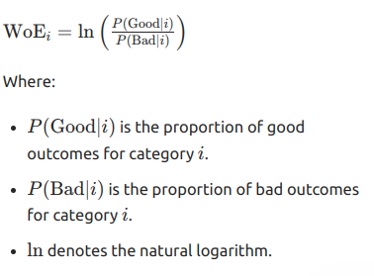
Mathematical Representation
The Weight of Evidence for a feature category, can be calculated using the following formula:

Slide 8
Interpretation of WoE Values
Positive WoE: Indicates that the feature category is associated with a higher likelihood of a good outcome. The higher the WoE, the stronger the positive relationship.
Negative WoE: Indicates that the feature category is associated with a higher likelihood of a bad outcome. The lower the WoE, the stronger the negative relationship.
WoE of Zero: Suggests that the feature category has no predictive power; the likelihood of good and bad outcomes is equal.
The WoE values can be used as input features in machine learning models, providing a more interpretable representation of the relationship between features and the target variable.

Slide 9
Information Value (IV)
Information Value (IV) is a metric used to measure the predictive power of a feature in relation to a binary outcome (e.g., good vs. bad credit risk).
It quantifies how well a feature separates the two classes, indicating the strength of the relationship between the feature and the target variable.
The primary purpose of IV is to evaluate the usefulness of a variable in predicting the target outcome.
A higher IV value suggests that the feature is more effective at distinguishing between good and bad outcomes, making it a valuable tool in feature selection and model building, particularly in credit scoring.

Slide 10
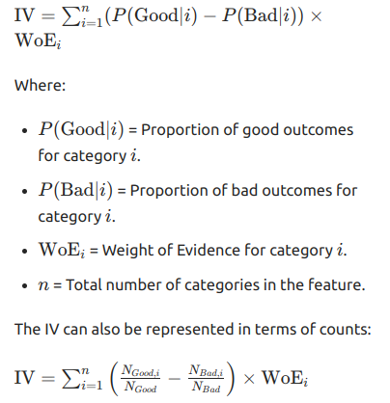
How IV is Calculated
The Information Value for a feature can be calculated using the following formula:

Slide 11
Interpretation of IV Values
The interpretation of IV values is generally categorized as follows:
IV < 0.02: Not useful for prediction
0.02 ≤ IV < 0.1: Weak predictive power
0.1 ≤ IV < 0.3: Medium predictive power
0.3 ≤ IV < 0.5: Strong predictive power
IV ≥ 0.5: Very strong predictive power
These thresholds provide guidance on whether to retain or discard a feature based on its predictive capability.

Slide 12
Application of WoE and IV in Credit Scoring
Weight of Evidence (WoE) and Information Value (IV) are essential in credit scoring as they provide a structured approach to evaluate the predictive capacity of various features.
WoE transforms categorical and continuous variables into a standardized format, enhancing the interpretability of the model.
IV quantifies the strength of the relationship between features and the binary target outcome (e.g., good vs. bad credit risk), guiding the selection of features that contribute most to predictive accuracy.

Slide 13
Benefits of Using WoE and IV
Enhanced Predictive Power: By identifying and retaining the most informative features, WoE and IV improve the overall accuracy of predictive models.
Interpretability: WoE provides a clear and interpretable measure of the impact of each feature, which is crucial for regulatory compliance in credit scoring.
Feature Selection: IV helps in selecting features based on their predictive strength, simplifying the modeling process and reducing complexity.
Handling Imbalanced Data: WoE effectively manages imbalanced datasets by highlighting the differences between good and bad outcomes, allowing for better risk assessment.

Slide 14
Any questions?

